Slide 1
DYSIDER (Dyslexia Aider)
K. Subhadharshini – 2018115113
V. Vishalini - 2018115132

Slide 2
Why have you chosen this project?
Dyslexia is a specific language disorder of neurobiological origin. The condition causes reading, writing and speaking issues amongst growing children.
It can be corrected with strategies geared to the innate strengths shared by dyslexic kids and individuals.
Through this project we aim to give engaging support to dyslexic kids.
With the help of appealing visual and textual aids, this application will help them improve their word recognition, vocabulary, spelling and decoding abilities.

Slide 3
Is your project available elsewhere?
On choosing this project, we began to search the internet for projects that have addressed the same condition.
But we couldn’t find any functional mobile or web application that gives a fun and engaging support for dyslexic kids, like how we had in mind.
Our project contains various modules, out of which some modules are inspired from existing games.

Slide 4
Design of your project.
Our project is a web application called ‘Dysider’.
It contains 5 different modules created to address the common issues faced by dyslexic children.
The modules are phonics, vowels, word formation, speech and colours. As far as we have explored, these are the levels in which dyslexic kids commonly face issues in learning.
With the help of appealing visual and textual aids in each module, this application will help the kids improve their word recognition, vocabulary, spelling and decoding abilities.

Slide 5
Home Page
Dashboard
Phonics
Vowels
Words
Speech
Colours

Slide 6
Phonics
Phonic Wall
Find The Phonic Game
Vowels
Vowel Game
Words
Anagram Game
Speech
Speech Practice
Colours
RGB Model
RGB Game
Cube Game

Slide 7
User
Home Page
Dashboard Page
1
Phonics
Kids will begin by learning the phonics of the English Alphabet.
2
Vowels
Next, they will learn vowels and how to use them in common words.
3
Speech
With ample knowledge on phonics and vowels, kids can learn and spell words out loud.
4
Words
Now, the kids can try forming simple words, using the knowledge gained from previous modules.
5
Colours
Having learnt to form words, they will be taught to match colours to their words. Here, kids also get to learn the RGB colour model from practice.

Slide 8
Algorithms (if any)
No, we don’t have any algorithm implementation in our project.

Slide 9
What is the portion you have completed so far? What is the role of each member?
We have completed the project. We had some minor UI changes to be done. It was done right away.
Since our project contains various modules, we have divided the work involved in developing each module amongst ourselves.
Subhadharshini, has completed the entire website design. She has worked on the speech module, vowel module and has helped with the word formation module.
Vishalini, has worked on the phonic wall module, colour module and has also contributed to the anagram game of the word formation module.

Slide 10
What is the role of each member?
K. Subhadharshini 2018115113
Word Formation Module
Speech Module
Vowel Module
V. Vishalini 2018115132
Phonic Module
Colour Module
Word Formation Module

Slide 11
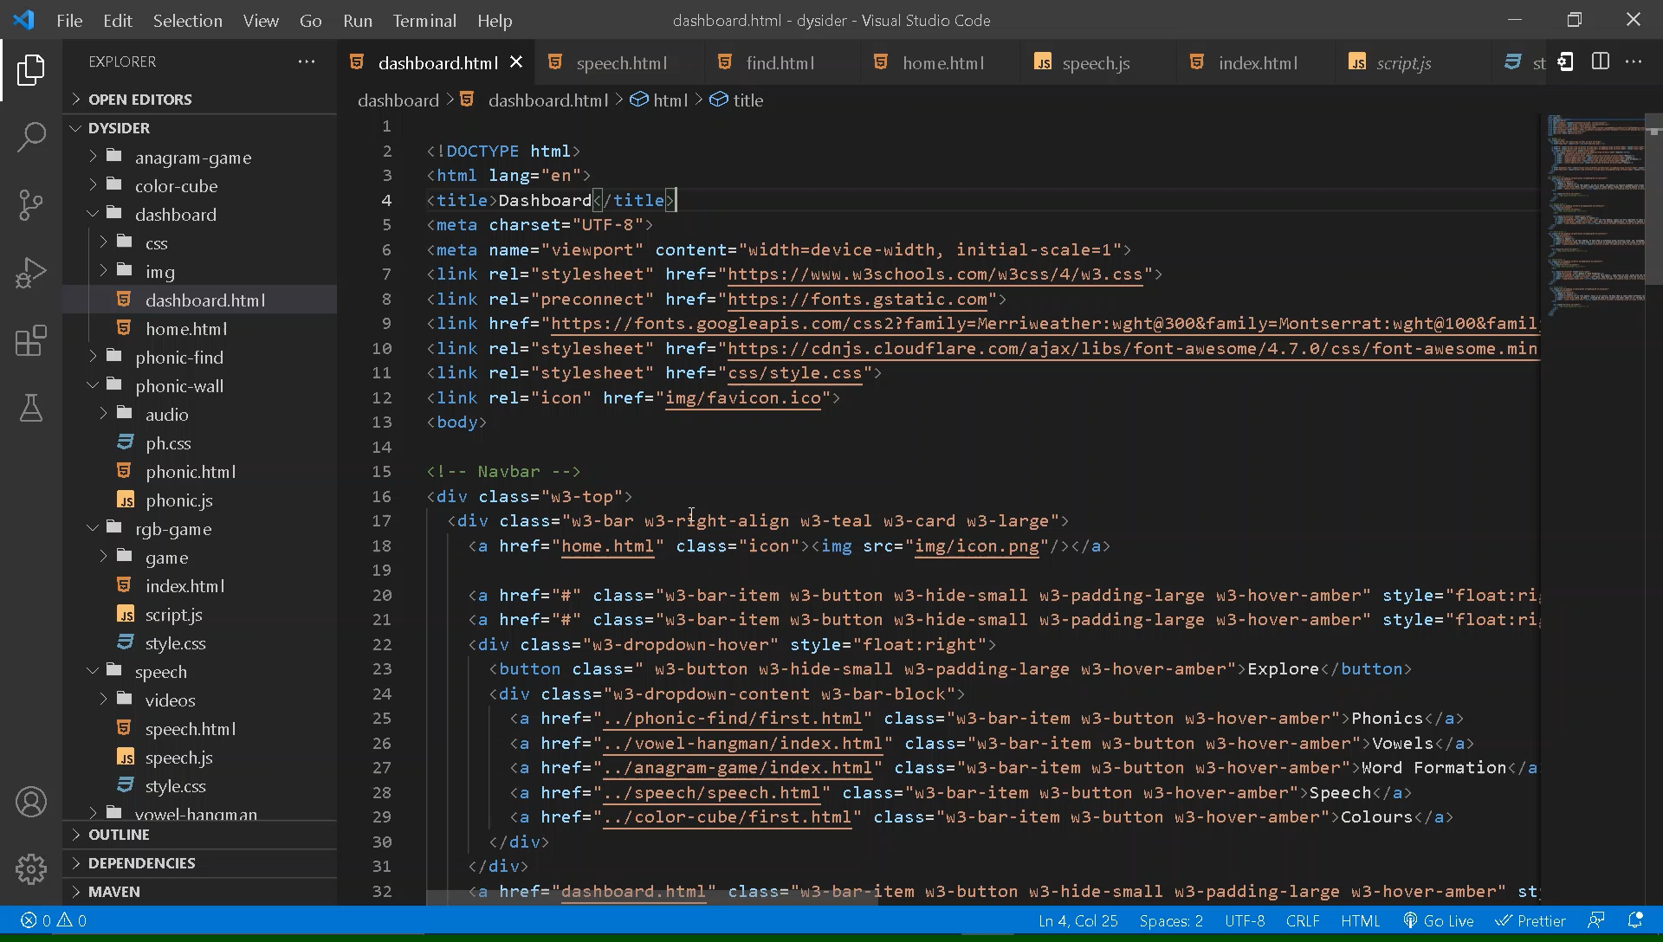

Slide 12
What is the innovation involved in your project?
With this project, we aim to help the dyslexic kids overcome commonly faced issues and increase their learning curve.
Since, sometimes plain teaching methods can get boring, we have planned to bring in a fun twist to learning, by including engaging games and visual aids.
Each module has features, that aim to address common problems faced by dyslexic kids, while kindling their creative potential.
Each module is designed in an incremental fashion, such that each module is a level higher than the previous module. This makes it a smooth learning curve for the dyslexic kids.

Slide 13
Are you satisfied with your work. If yes, why? If no, why?
We are satisfied with our work. We had done extensive research on the topic before starting on the project.
As far as we have explored, there are various levels in which dyslexic kids commonly face issues in learning. We have included them as modules in our project, aided with engaging audio visual aids.
We both worked together on all the modules. In spite of the various hurdles we faced while working on our project, we managed to successfully complete it.

Slide 14
On 25, how will you evaluate your own work. Why?
We would give our work a 22 out of 25. The reason for the score is same as what we had discussed earlier.
We started working on our project pretty late, because we had to do extensive research on the topic.
But once we started, all the modules came together well. In spite of the various hurdles we faced while working on our project, we managed to successfully complete it.

Slide 15
THE END

